Slide 1
Intro to Relational Model

Slide 2
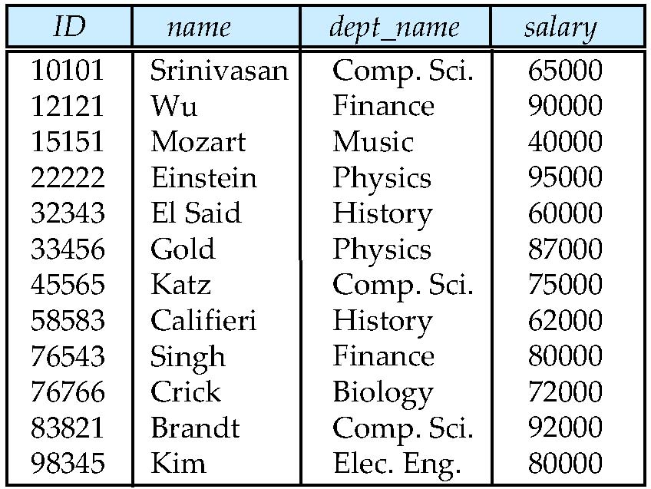
Example of a Relation
Example of a Relation
attributes
(or columns)
tuples
(or rows)

Slide 3
Attribute Types
The set of allowed values for each attribute is called the domain of the attribute
Attribute values are (normally) required to be atomic; that is, indivisible
The special value null is a member of every domain. Indicated that the value is “unknown”
The null value causes complications in the definition of many operations

Slide 4
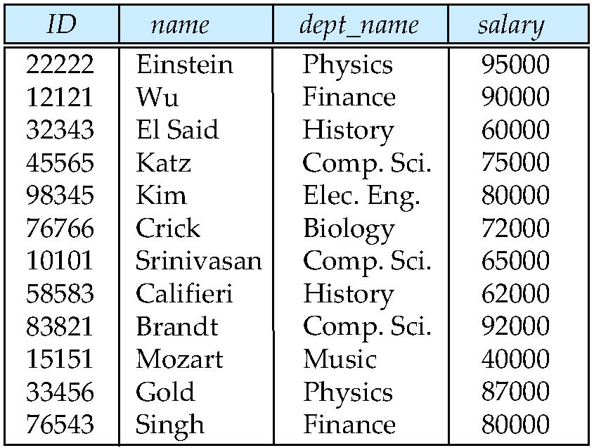
Relations are Unordered
Order of tuples is irrelevant (tuples may be stored in an arbitrary order)
Example: instructor relation with unordered tuples

Slide 5
Relations are Unordered
Database schema is the logical structure of the database.
Database instance is a snapshot of the data in the database at a given instant in time.
Example:
schema:
instructor (ID, name, dept_name, salary)
Instance:

Slide 6
Keys
Let K ⊆ R
K is a superkey of R if values for K are sufficient to identify a unique tuple of each possible relation r(R)
Example: {ID} and {ID,name} are both superkeys of instructor.
Superkey K is a candidate key if K is minimal Example: {ID} is a candidate key for Instructor
One of the candidate keys is selected to be the primary key.
Foreign key constraint: Value in one relation must appear in another
Referencing relation
Referenced relation
Example – dept_name in instructor is a foreign key from instructor referencing department

Slide 7
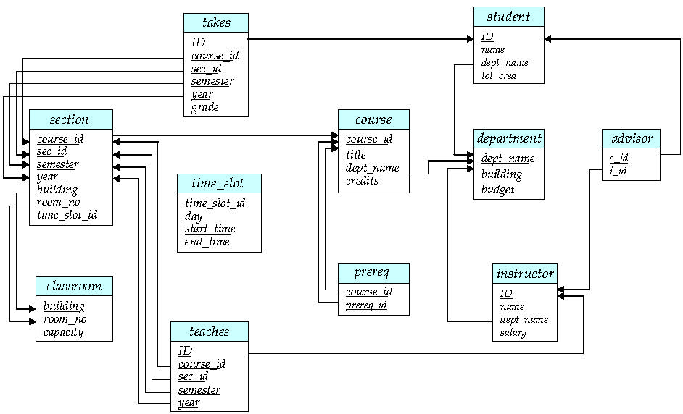
Schema Diagram for University Database

Slide 8
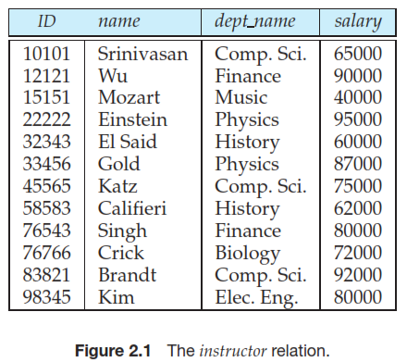
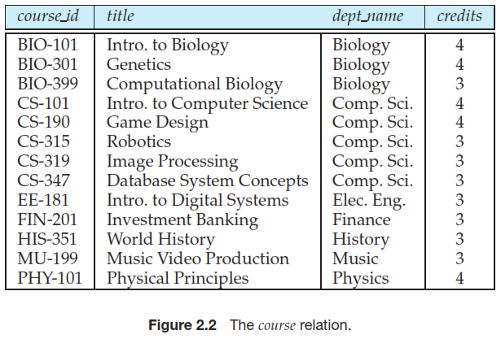

Slide 9
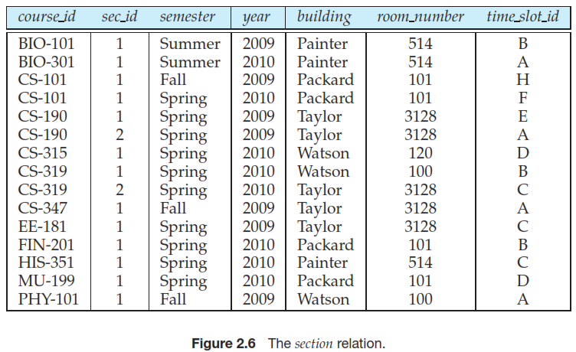
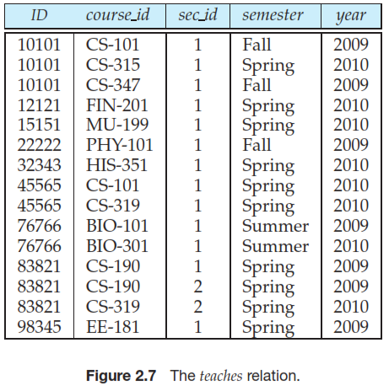
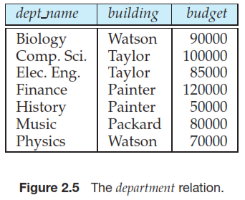

Slide 10
Relation Schema and Instance
A₁, A₂, …, A_{n} are attributes
R = (A₁, A₂, …, A_{n} ) is a relation schema
Example: instructor = (ID, name, dept_name, salary)
Formally, given sets D₁, D₂, …. D_{n} a relation r is a subset of D₁ x D₂ x … x D_{n} Thus, a relation is a set of n-tuples (a₁, a₂, …, a_{n}) where each a_{i} ∈ D_{i}
The current values (relation instance) of a relation are specified by a table
An element t of r is a tuple, represented by a row in a table

Slide 11
Relational Query Languages
Procedural vs non-procedural, or declarative
“Pure” languages:
Relational algebra
Tuple relational calculus
Domain relational calculus
The above 3 pure languages are equivalent in computing power

Slide 12
Relational Algebra
A procedural language consisting of a set of operations that take one or two relations as input and produce a new relation as their result.
Six basic operators
select: σ
project: ∏
union: ∪
set difference: –
Cartesian product: x
rename: ρ

Slide 13
Select Operation
The select operation selects tuples that satisfy a given predicate.
Notation: σ _{p} (r)
p is called the selection predicate
Example: select those tuples of the instructor relation where the instructor is in the “Physics” department.
Query
σ _{dept_name=“Physics”} (instructor)

Slide 14
Select Operation
We allow comparisons using =, ≠, >, ≥, <, ≤ in the selection predicate.
We can combine several predicates into a larger predicate by using the connectives: ∧ (and), ∨ (or), ¬ (not)
Example: Find the instructors in Physics with a salary greater $90,000, we write:
σ _{dept_name=“Physics”} ∧ _{salary>90000} (instructor)
Then select predicate may include comparisons between two attributes.
Example, find all departments whose name is the same as their building name:
σ _{dept_name=building} (department)

Slide 15
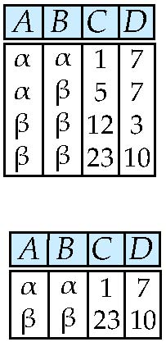
Select Operation – selection of rows (tuples)
Relation r
σ_{A=B ^ D > 5} (r)

Slide 16
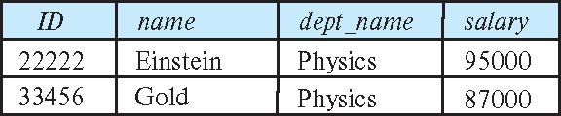
σ _{dept_name=“Physics”} (instructor)
σ _{dept_name=building} (department)

Slide 17
Project Operation
A unary operation that returns its argument relation, with certain attributes left out.
Notation:
∏ _{A1,A2,A3 ….Ak} (r)
where A₁, A₂ are attribute names and r is a relation name.
The result is defined as the relation of k columns obtained by erasing the columns that are not listed
Duplicate rows removed from result, since relations are sets

Slide 18
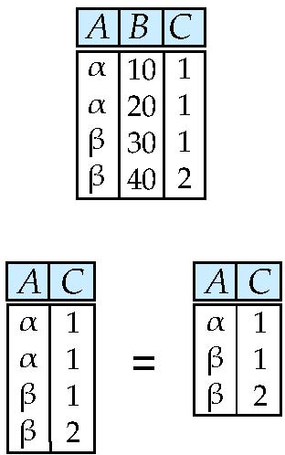
Project Operation – selection of columns (Attributes)
Relation r
∏_{A,C} (r)

Slide 19
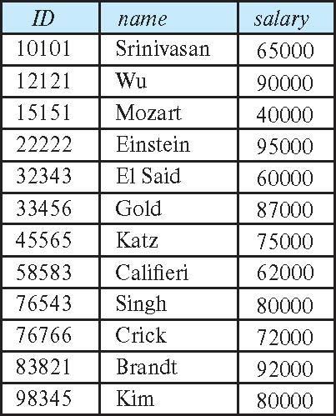
Project Operation
Example: eliminate the dept_name attribute of instructor
Query: ∏_{ID, name, salary} (instructor)
Result:

Slide 20
Cartesian-Product Operation
The Cartesian-product operation (denoted by X) allows us to combine information from any two relations.
Example: the Cartesian product of the relations instructor and teaches is written as: instructor X teaches
We construct a tuple of the result out of each possible pair of tuples: one from the instructor relation and one from the teaches relation.
Since the instructor ID appears in both relations we distinguish between these attribute by attaching to the attribute the name of the relation from which the attribute originally came.
instructor.ID
teaches.ID

Slide 21
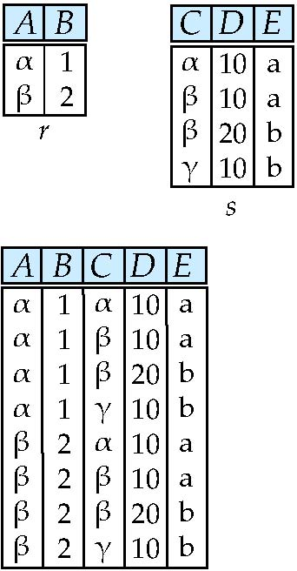
Joining two relations - Cartesian-product
Relations r, s:
r x s:

Slide 22
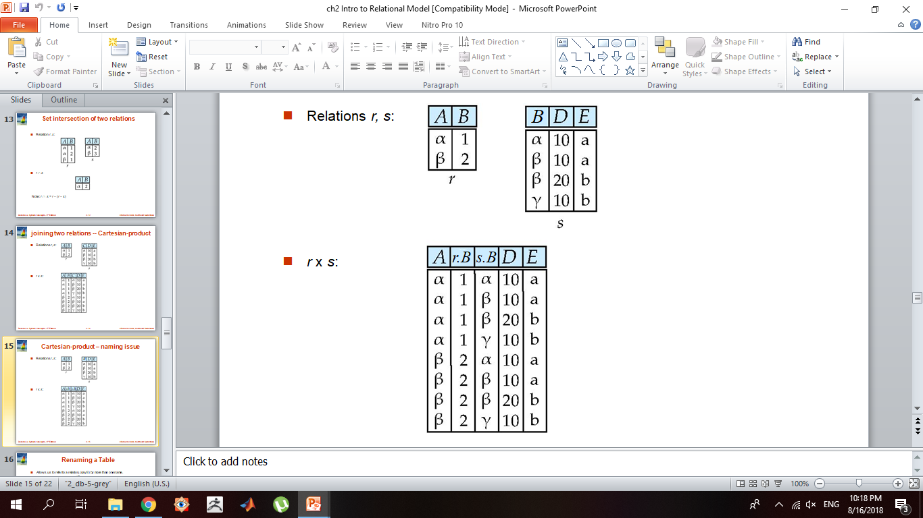
Cartesian-product – naming issue
Relations r, s:
r x s:

Slide 23
The instructor X teaches table

Slide 24
Join Operation
The Cartesian-Product : instructor X teaches associates every tuple of instructor with every tuple of teaches.
Most of the resulting rows have information about instructors who did NOT teach a particular course.
To get only those tuples of “instructor X teaches “ that pertain to instructors and the courses that they taught, we write:
σ _{instructor.id = teaches.id} (instructor x teaches )

Slide 25
Joining two relations – Natural Join
Let r and s be relations on schemas R and S respectively. Then, the “natural join” of relations R and S is a relation on schema R ∪ S obtained as follows:
Consider each pair of tuples t_{r} from r and t_{s} from s.
If t_{r} and t_{s} have the same value on each of the attributes in R ∩ S, add a tuple t to the result, where
t has the same value as t_{r} on r
t has the same value as t_{s} on s

Slide 26
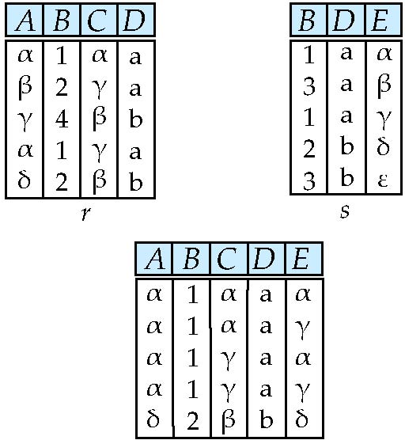
Natural Join Example
Natural Join
r s
Relations r, s:
∏ _{A, r.B, C, r.D, E} (σ _{r.B = s.B ˄ r.D = s.D} (r x s)))

Slide 27
Union Operation
The union operation allows us to combine two relations
Notation: r ∪ s
For r ∪ s to be valid.
1. r, s must have the same arity (same number of attributes)
2. The attribute domains must be compatible (example: 2nd
column of r deals with the same type of values as does the 2nd column of s)
Example: to find all courses taught in the Fall 2017 semester, or in the Spring 2018 semester, or in both ∏_{course_id} (σ _{semester=“Fall” Λ year=2009} (section)) ∪ ∏_{course_id} (σ _{semester=“Spring” Λ year=2010} (section))

Slide 28
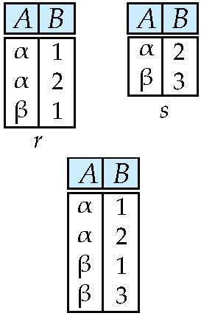
Union of two relations
Relations r, s:
r ∪ s:

Slide 29
Union Operation
∏_{course_id} (σ _{semester=“Fall” Λ year=2009} (section)) ∪ ∏_{course_id} (σ _{semester=“Spring” Λ year=2010} (section))

Slide 30
Set-Intersection Operation
The set-intersection operation allows us to find tuples that are in both the input relations.
Notation: r ∩ s
Assume:
r, s have the same arity
attributes of r and s are compatible
Example: Find the set of all courses taught in both the Fall 2009 and the Spring 2010 semesters.
∏_{course_id} (σ _{semester=“Fall” Λ year=2009}(section)) ∩ ∏_{course_id} (σ _{semester=“Spring” Λ year=2010} (section))

Slide 31
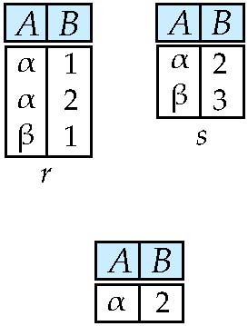
Set intersection of two relations
Relation r, s:
r ∩ s
Note: r ∩ s = r – (r – s)

Slide 32
∏course_id (σ _{semester=“Fall” Λ year=2009} (section)) ∩ ∏_{course_id} (σ semester=“Spring” Λ year=2010 (section))

Slide 33
Set Difference Operation
The set-difference operation allows us to find tuples that are in one relation but are not in another.
Notation r – s
Set differences must be taken between compatible relations.
r and s must have the same arity
attribute domains of r and s must be compatible
Example: to find all courses taught in the Fall 2017 semester, but not in the Spring 2018 semester ∏_{course_id} (σ _{semester=“Fall” Λ year=2009} (section)) − ∏_{course_id} (σ _{semester=“Spring” Λ year=2018} (section))

Slide 34
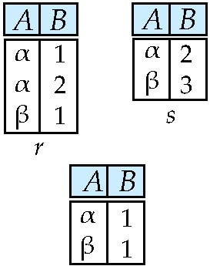
Set difference of two relations
Relations r, s:
r – s:

Slide 35
The Rename Operation
The results of relational-algebra expressions do not have a name that we can use to refer to them. The rename operator, ρ , is provided for that purpose
The expression:
ρ_{x} (E)
returns the result of expression E under the name x
Another form of the rename operation:
ρ_{x(A1,A2, .. An)} (E)

Slide 36
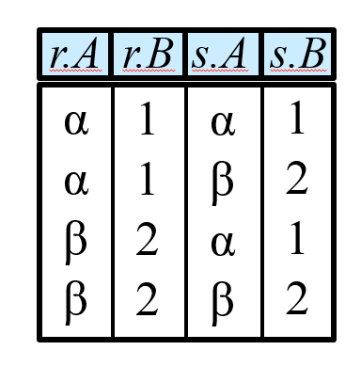
Renaming a Table
Allows us to refer to a relation, (say E) by more than one name.
ρ _{x} (E)
returns the expression E under the name X
Relations r, s:
r x ρ _{s} (r)

Slide 37
Composition of Relational Operations
The result of a relational-algebra operation is relation and therefore of relational-algebra operations can be composed together into a relational-algebra expression.
Consider the query -- Find the names of all instructors in the Physics department.
∏_{name}(σ _{dept_name} _{=“Physics”} (instructor))
Instead of giving the name of a relation as the argument of the projection operation, we give an expression that evaluates to a relation.

Slide 38
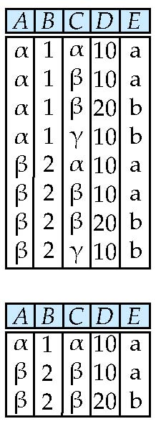
Composition of Operations
Can build expressions using multiple operations
Example: σ_{A=C} (r x s)
r x s
σ_{A=C} (r x s)

Slide 39
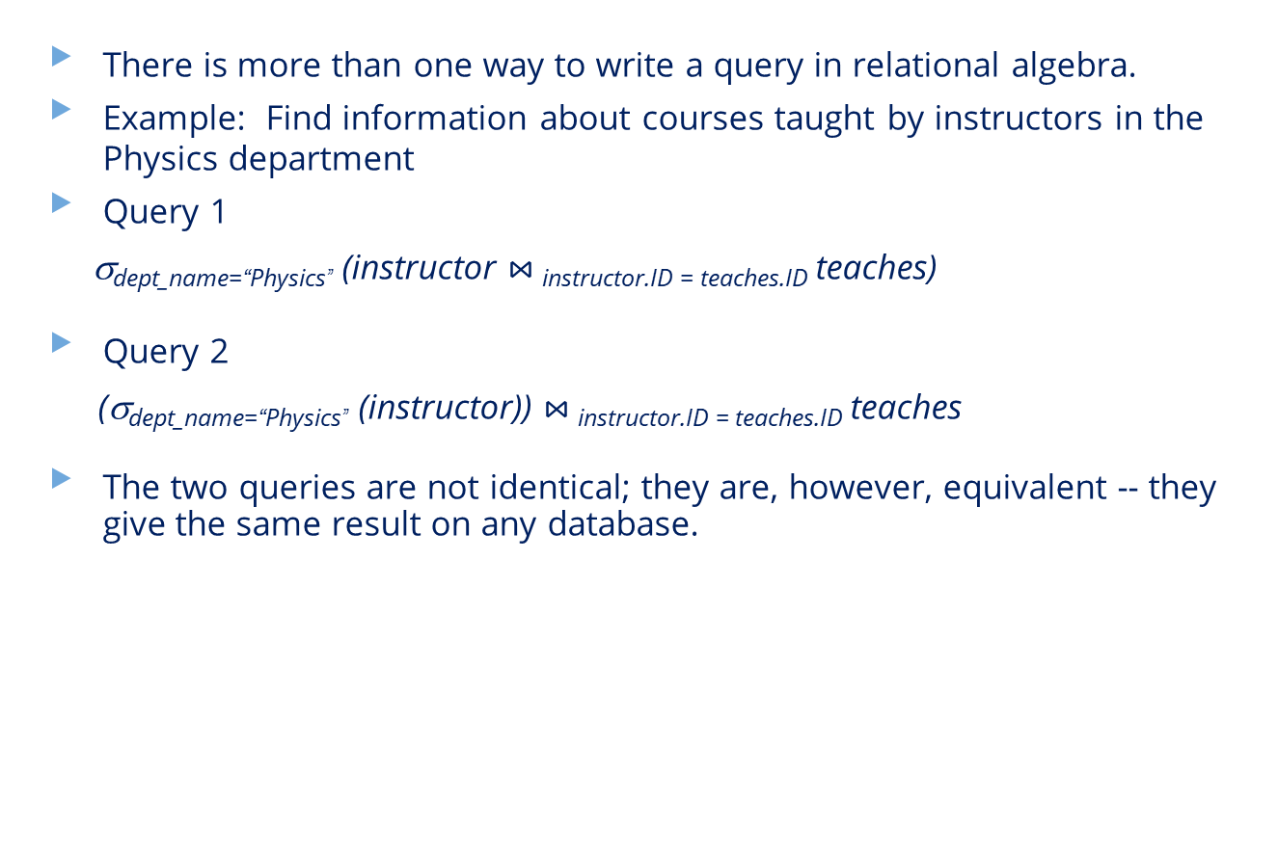
Equivalent Queries
There is more than one way to write a query in relational algebra.
Example: Find information about courses taught by instructors in the Physics department
Query 1
σ_{dept_name=“Physics”} (instructor $⋈_{ }$_{instructor.ID = teaches.ID} teaches)
Query 2
(σ_{dept_name=“Physics”} (instructor)) $⋈_{ }$_{instructor.ID = teaches.ID} teaches
The two queries are not identical; they are, however, equivalent -- they give the same result on any database.

Slide 40
Notes about Relational Languages
Each query input is a table (or set of tables)
Each query output is a table.
All data in the output table appears in one of the input tables
Can we compute:
SUM
AVG
MAX
MIN

Slide 41
